Slide 1
How R is improving the dissemination of statistics within the Department for Work and Pensions
Aoife O’Neill
Department for Work and Pensions
England
Twitter: Stats_o

Slide 2
Including
What is DWP?
Official statistics in DWP
An introduction to RAP ( a new way of producing statistics)
How we have implemented RAP at DWP
Notes:
What is DWP?
Official statistics in DWP
An introduction to RAP ( a new way of producing statistics)
How we have implemented RAP at DWP

Slide 3
What is DWP?
UK’s biggest government department.
Responsible for administering pension, working age, as well as disability and health related, benefits
Statistics used by a range of customers such as local government
Notes:
The 1942 Beveridge Report set out a system of social insurance, covering every citizen regardless of income. It offered nothing less than a cradle-to-grave welfare state. Since then, various departments have been responsible for this collection of benefits, but today the responsibility is held by DWP.
UK’s biggest government department. with 20 million customers
€200 billion in expenditure every year
Responsible for Administering pension, working age, as well as disability and health related, benefits
Statistics used by a range of customers such as local government
Statistics used by a range of customers such as local government, who rely on our statistics for strategizing how they provide services.
With such a large responsibility, it is important that accurate and reliable statistics are being produced by the Department.

Slide 4
Official statistics in DWP
“ We have no axe to grind in any debate, save that it is well informed”
John Pullinger (National Statistician)
Notes:
“ We have no axe to grind in any debate, save that it is well informed”- emphasise what this means
DWP, like all other government departments in Great Britain, must adhere to the code of pratcie
They’re statistics which are presented impartially as they have to adhere to the code of practice . This means that they are presented with transparent judgements and include what the strengths and limitations of these statistics are. If a department fails to adhere to the code, we will face criticism from the national statistician.
Matt Upson, a formal UK civil servant, highlighted how, unlike in academia where there are numerous journal articles on a topic, official statistics are often “the single source of truth”. This is especially true in DWP, where the department is responsible for deploying its resources, as well as developing policy, meaning that it is the source of statistics on the services it provides. For example, only we can report on how many households are receiving Universal Credit, nobody else is gathering that data.
They are an essential public asset.
They are intended to serve the public. Academics and charities use these figures to inform their researches and strategies how they provide services.
Helps to hold the government accountable.

Slide 5
Official Statistics publication process
Data creation
Manually update SAS code with parameters
SAS code ran and analytical output produced
Data received in CSV format and variables removed/added for Stat X-plore upload
Data manually imported to SQL server and views created
Dashboard is updated automatically with new data and published online.
CSV converted in to SXV4 file
Automated: Data for Analytical dashboard is automatically retrieved from Open Data API
Copy and paste values from SAS and Stat X-plore in to publication tables in Excel
SXV4 file uploaded to Stat X-plore and data undergoes perturbation through back end systems which program Stat X-plore
Manual: Data for analytical dashboard outputted from Stat X-plore in to Excel table
Copy and paste values from SAS output or Excel tables to create publication graphs
Update title page on Stat X-plore with current and next publication date through HTML coding
Paste Stat X-plore data in to a spreadsheet where equations create arrays
Copy and paste values and graphs from Excel in to word document.
Update pre-made Stat X-plore tables in Super Cross
Update the code in JSON file so that it picks up updated arrays
Draft commentary to reflect data in word document
Data and pre-made tables published online on Stat X-plore
Dashboard updated and published online
Publish statistical bulletin online as a PDF document alongside Excel tables
Notes:
Before I give an introduction to RAP, I want to quickly cover the stats publication process.
Guessing everyone here, has produced a stats publication before?
This is the current process that occurs in DWP to produce statistics. Some parts are unqiue to DWP, but in general this is how official statistics are produced across the UK and I suspect, will be familiar to my international colleagues?
Essentially, this diagram shows…

Slide 6

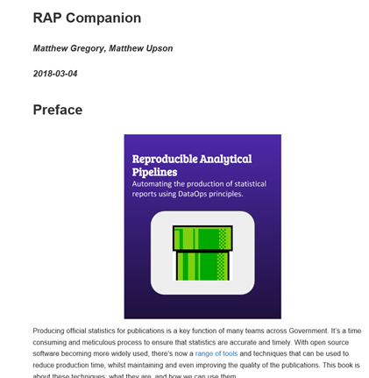
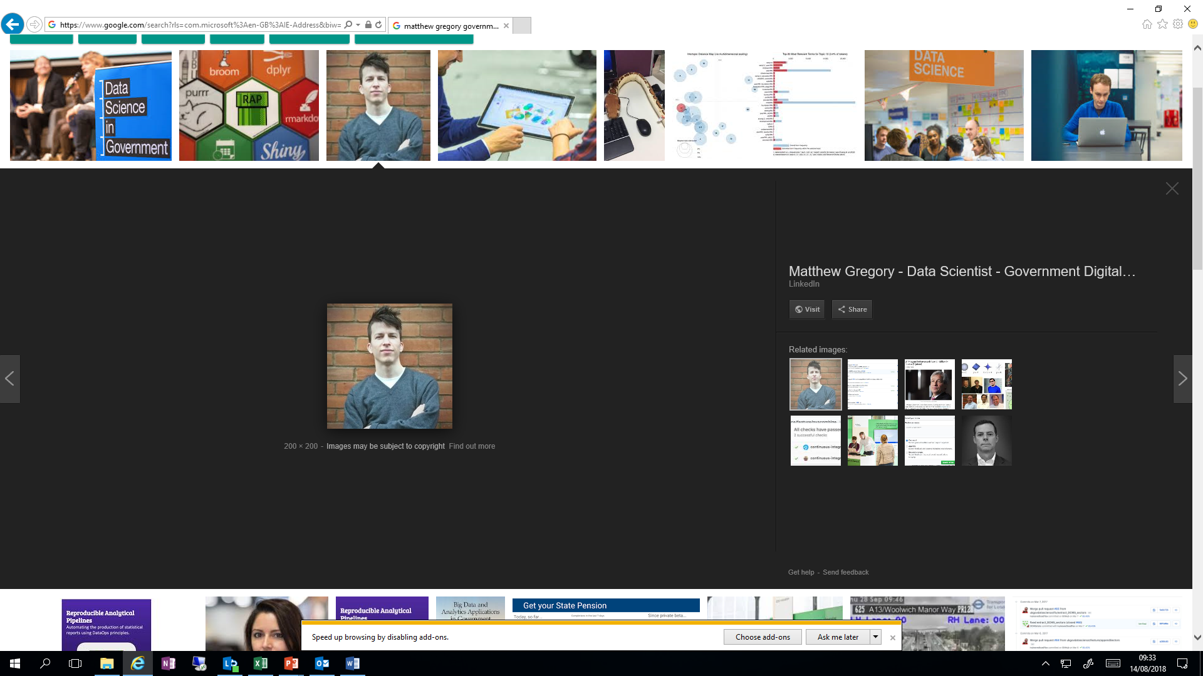
Matthew Gregory and Matthew Upson, the creators of RAP
Notes:
That was the problem, these two guys came up with the solution, and it was called RAP. These two guys created the principles behind RAP. They have been great at producing guidelines on how people should be implementing RAP for official statistics.
Wrote an e-book
Wrote a blog
Created free online training
Put a package they’ve designed on git
Thanks to their publicising of RAP, there are at least 6 government departments in the UK implimenting RAP and producing their official statistics in a new way.

Slide 7

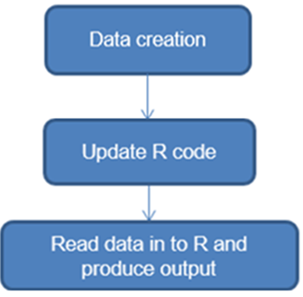
Notes:
Reproducible Analytical Pipelines (RAP) is a new way of producing statistics, where rather then manually creating a new statistical release every publication cycle, much of the work is automated using R Markdown.
Using the RAP principals, we can streamline the stats production process so that it is far simpler, producing the statistics using R Markdown, rather then a mix of SAS/SPSS, Microsoft excel, Word and copy and paste.
By using R Markdown you ensure that your analytical work is no longer separate from your output.

Slide 8






Reproducible
Analytical
Pipeline
Notes:
Having read the e-book on RAP, various blog posts, and speaking to statisticians in other government departments who have implemented RAP. I decided to design my pipeline using the following software components:
The Pipeline itself has been designed in R Markdown which is an add on to R studio. The R Markdown package allows you to insert chunks of R code in to a document, meaning that your analytical code no longer needs to be in a separate document (and software) to your commentary. R Markdown allows you to produce several different documents, such as a pdf, slide packs and word. It also can understand different languages such as python, css and javascript and many more.
Git and Docker were used to help ensure that my publication was reproducible. Docker allows the packages and exact version of R studio I have used to be saved as an image, that way I can always access the exact same environment that the original publication was made in. Meaning that I shouldn’t ever have the problem of my code breaking, because one of my packages has been updated.
In terms of producing my analysis, most of the statistics presented in the publication can be done using the functions within dplyr, a well known data manipulation package. I then used ggplot2, another Package, to turn these analysis in to graphs to visualise the data.

Slide 9
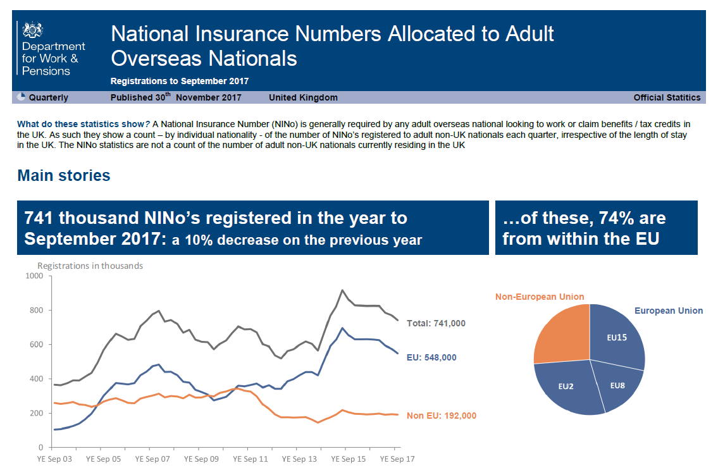
Notes:
So this is the publication I was asked to automate in R Markdown. It reports how many national insurance numbers are allocated to overseas nationals. National insurance numbers are normally referred to as “Ninos”, and this is how I’ll be referring to them henceforth. The reason why there is interest in these statistics is that receiving a national insurance number means that you can look for work in the UK or take up benefit, but it can not be used as a measure for the number of non-uk adults entering the UK.

Slide 10
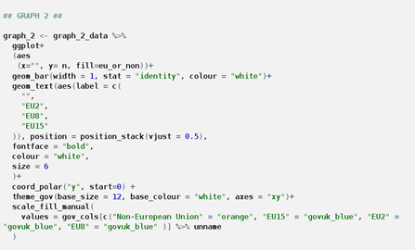
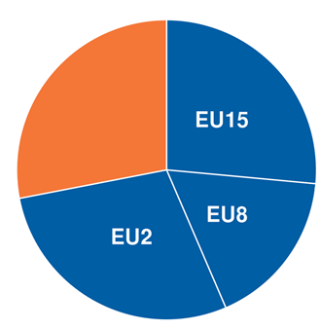
https://github.com/ukgovdatascience/govstyle
Notes:
I began the journey, wanting to see how easy it was to create the graphs and numeric text in R Markdown. I quickly found that thanks to the Gov Styles R package, which was designed by Matt Upson, it was relatively easy to employ the theme used in government publications and use the correct colours.
So creating graphs in R Markdown is all well and good, but …

Slide 11
…How do you format?
Notes:
How do you format?
How do you format something that looks like this using code?
We re-designed our bulletins, having looked in to user research on how people consume official statistics bulletins:
We’d learnt that people want to be able to spot the headline figures straight away (hence the large text boxes).
We’d chosen the colours orange and blue as people who are colour blind tend to be able to tell the difference between the two
We wanted to keep the layout of this page non-text heavy. As we know that users usually quickly scan text. Short chunks of text, divided by clear headings each with a specific focus are easier for users to understands.
When people have to dedicate more mental effort to try to understand something, they have less capacity to commit it to memory
Longer sentences hinder understanding
The more text there is the harder it is to find the bits on the page
Users come to a bulletin with a clear task in mind
Having researched Latex, and R Markdown. I decided the best solution was to use CSS and HTML, which can be used in R Markdown. HTML and CSS aren’t traditional statistician skills, but I’m hoping to show you today how easy it is to pick up the fundamentals of these languages and create HTML pages in the format you require. I also quickly came to the conclusion that HTML was better then PDF because they can be read by screen readers.

Slide 12
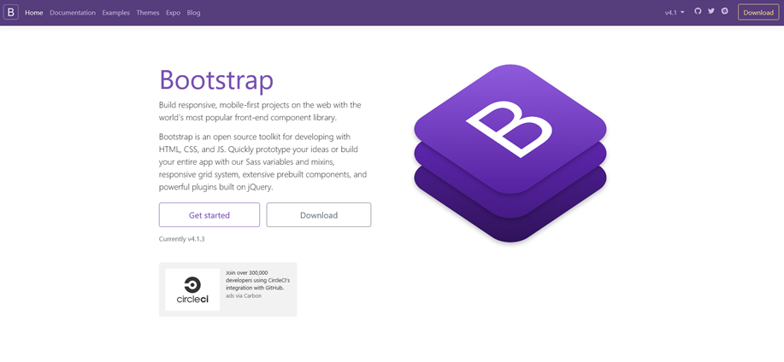
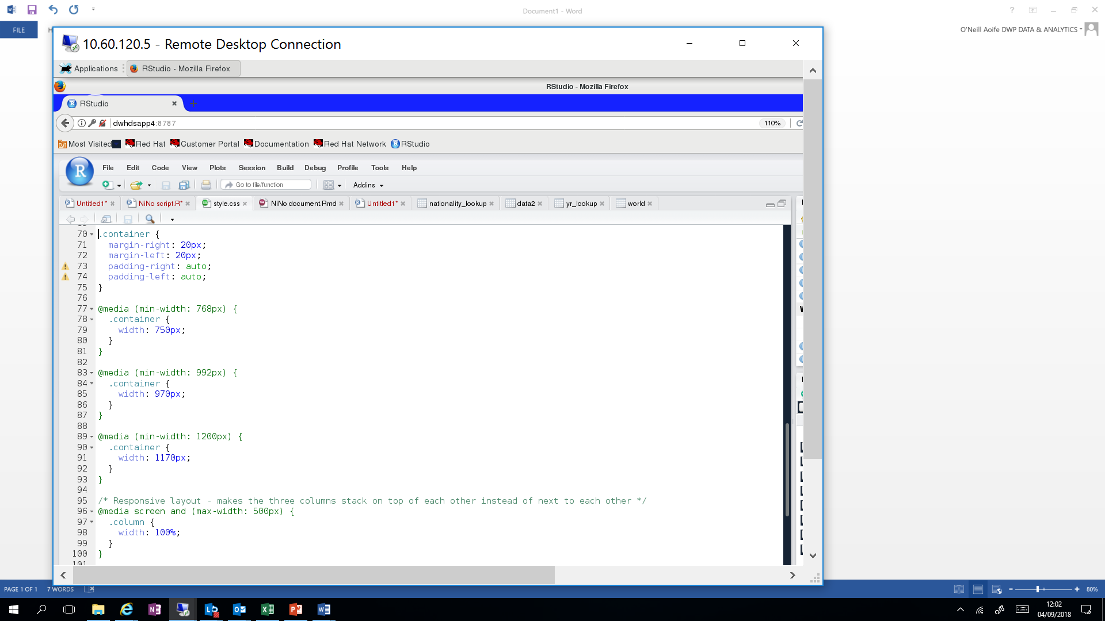
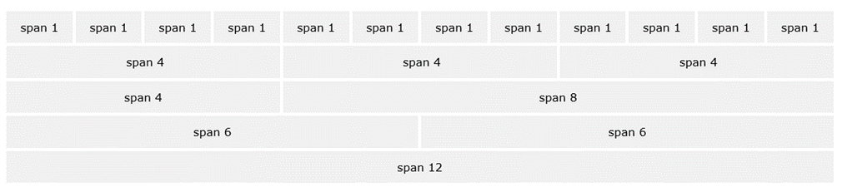
https://getbootstrap.com/docs/4.1/getting-started/introduction/
Notes:
The first formatting concern, was how do I maintain the structure of the report using HTML and CSS?
My answer to this was Bootstrap.
Bootstrap is a toolkit for developing HTML, CSS and JS, I think of it as a library of useful code I can use.
Within this library bootstrap shows how to make a responsive container system. The code for the system is freely available in boots strap’s website, some of which I’ve placed on the left hand side.
The responsive container system means that the layout of the content will change according to the size of the screen. This means that rather then your content becoming really small to fit on to say, a mobile phone, or becoming muddled, Bootstrap re-arranges the structure of your web page so that things appear one after another.
Within the container, content is arranged in rows. Each row can be split in to 12 columns, which will automatically vary according to the size of the screen. Grouping columns together can be used to create a wider column,

Slide 13
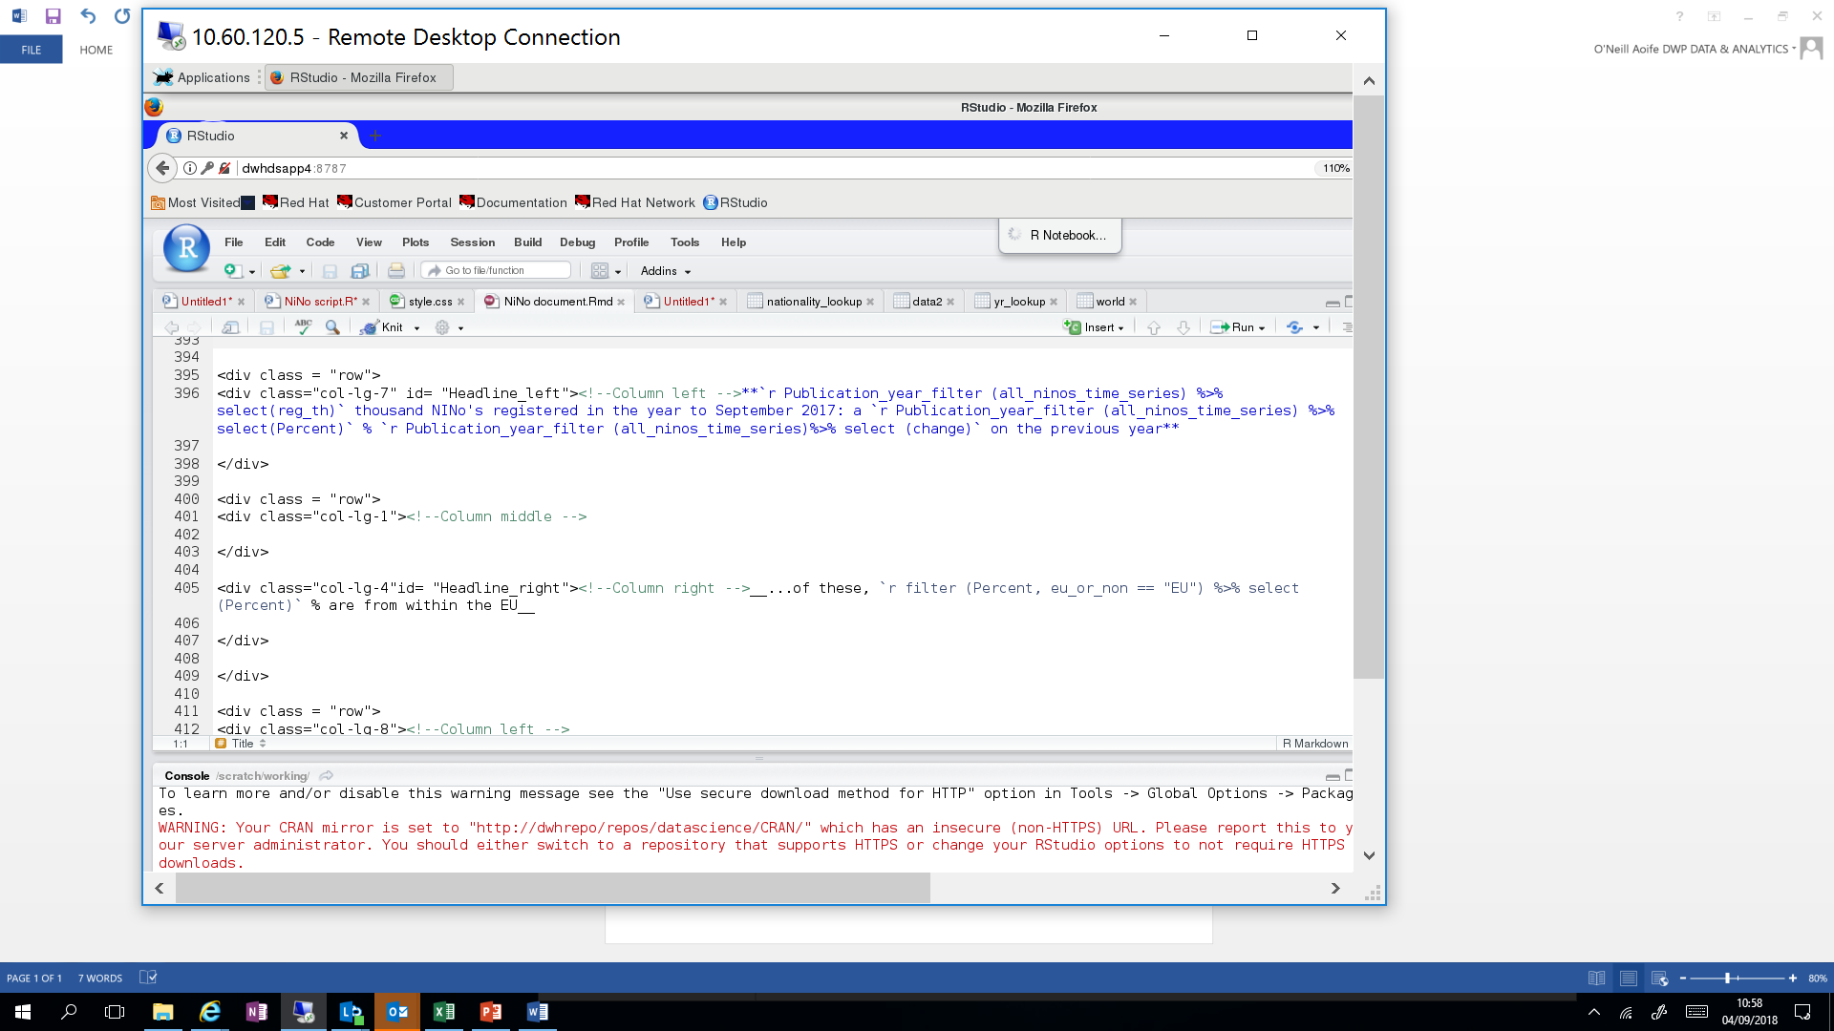
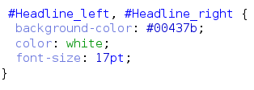
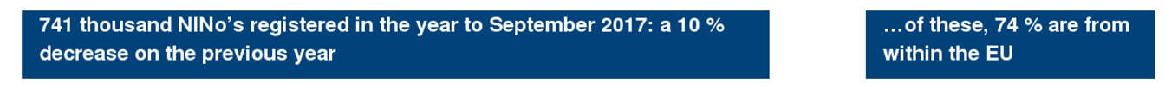
Notes:
Here is an example where I’ve, designated “rows” and “columns” here you see the code I used to create the row for the headline figures.
Once I’ve specified the beginning of a row, with <div class = “row”> I can then specify how many colums make up this row, and what size each one should be. In the case of the headline figures, there are 3 columns. A lefthand side column for the first box, a middle column for the white space and one on the right hand side.
My first column, whose ID is given as “Headline_left”, I’ve asked for it to take up the space of 7 colums, on a large screen, the middle column is one and the remaining is 4, this outputs a pretty good match.
In terms of colours and text styles, I use CSS. All my CSS is placed in a CSS style sheet,. Here we can see that I’ve assigned items with the ID headline left and headline right to have this royal blue background colour (which corresponds to a hex code of #00437b), white text and size 17 font. Placing things in a CSS sheet, means there is less code having to be placed in my R Markdown script.
You will also notice that the figures themselves are created using KnitR, rather then text.

Slide 14
Prototype Vs Real thing
Notes:
So very quickly and easily I acquired these skills. Although my prototype is not yet perfect, you can see it is very close to the original publication.

Slide 15
Conclusion
What is DWP?
Official statistics in DWP
An introduction to RAP ( a new way of producing statistics)
How we have implemented RAP at DWP
Notes:
DWP produces statistics which are integral for local authorities and charities, therefore our figures must be reliable
DWP statistics must adhere to the code of practice
RAP is a new way of producing official statistics, which will allow statisticians to produce more reliable statistics much more efficiently, freeing up time which can be spent instead providing insight or designing new collections
R Markdown’s ability to use HTML, means we can create exciting new statistical products
Statistician’s can easily begin to dabble in HTML
RAP is revolutionising statistics production in the UK
Using HTML in R Markdown means we can create new statistical products.
I encourage statisticians to try using HTML

